Slide 1
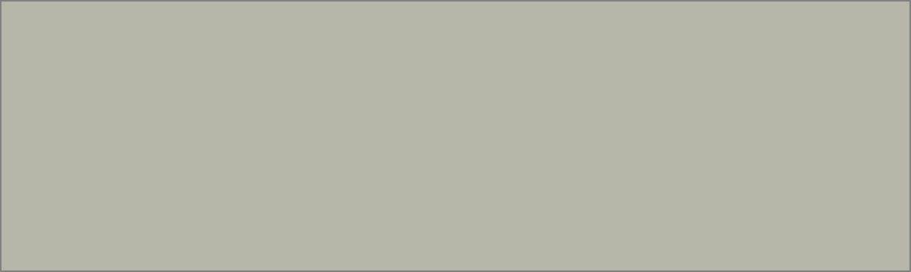

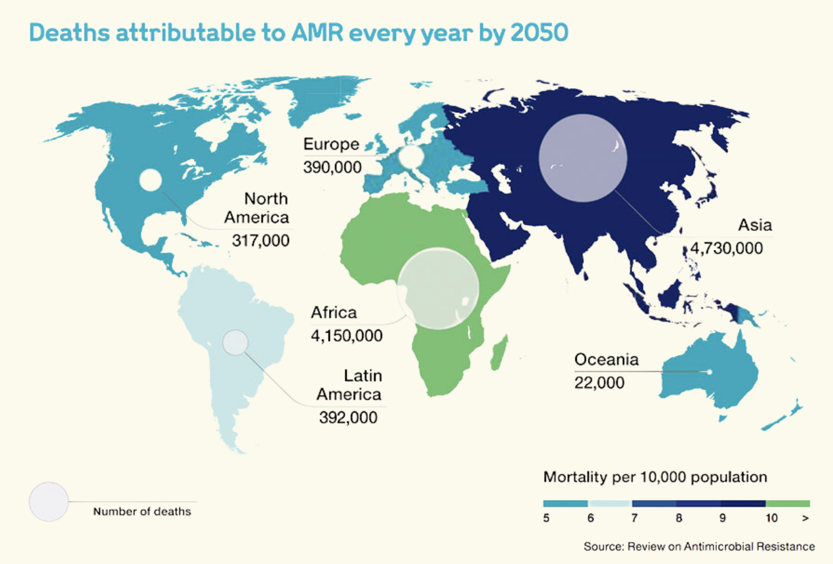

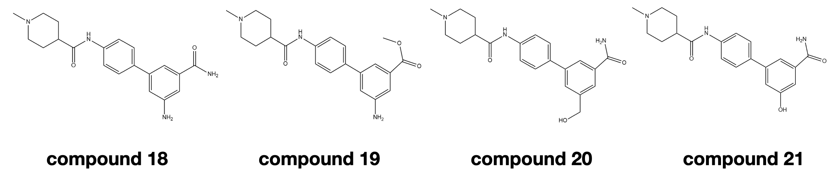


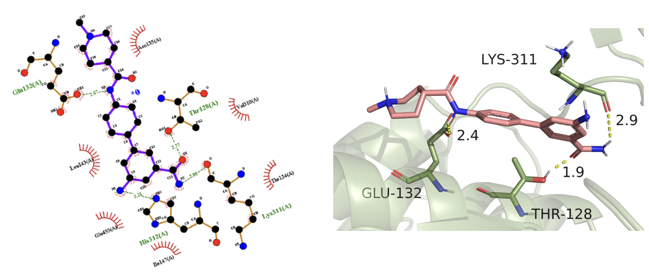
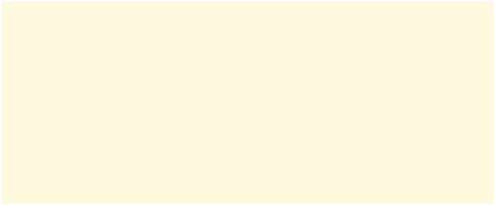
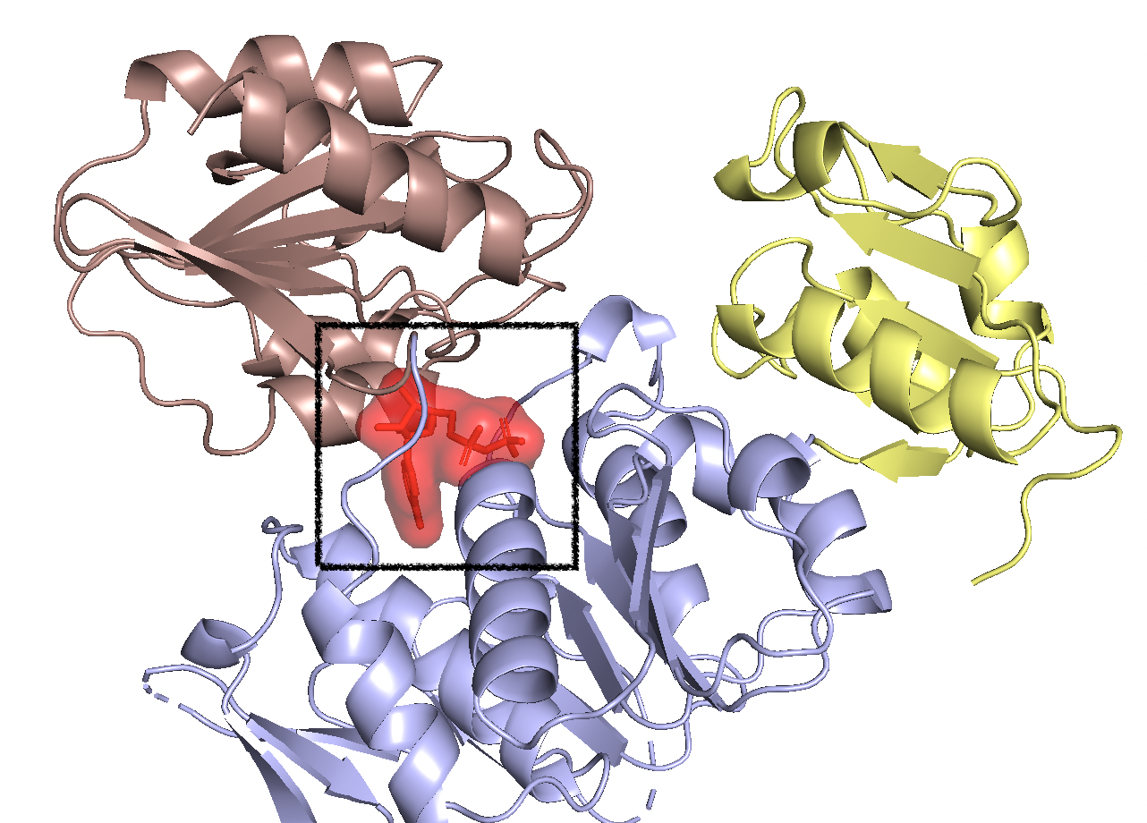


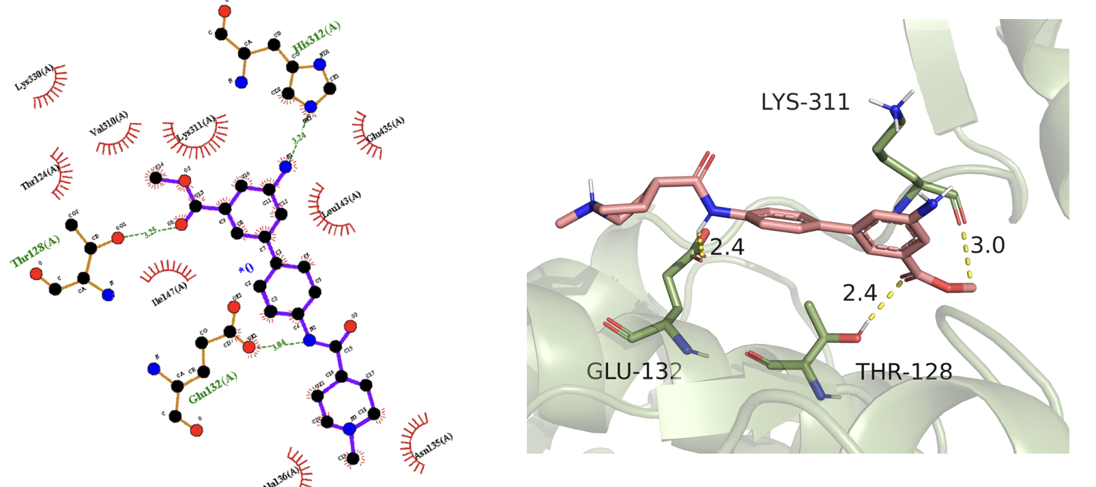



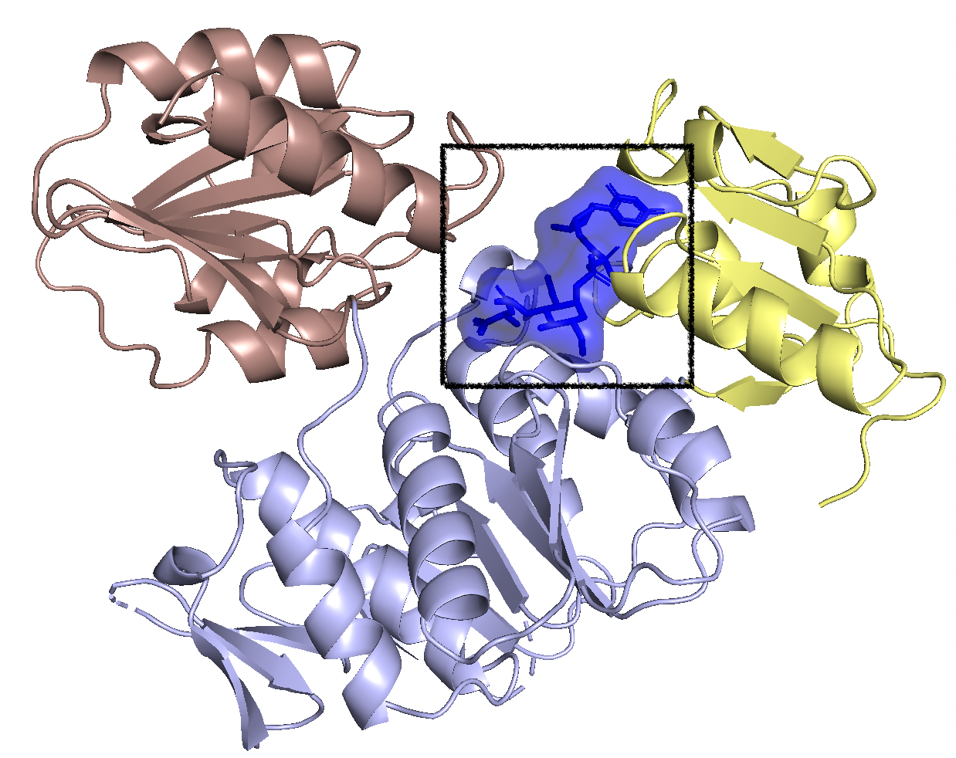
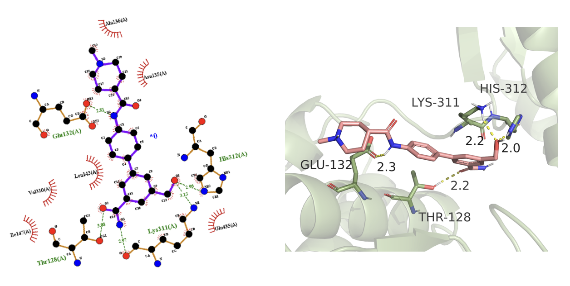

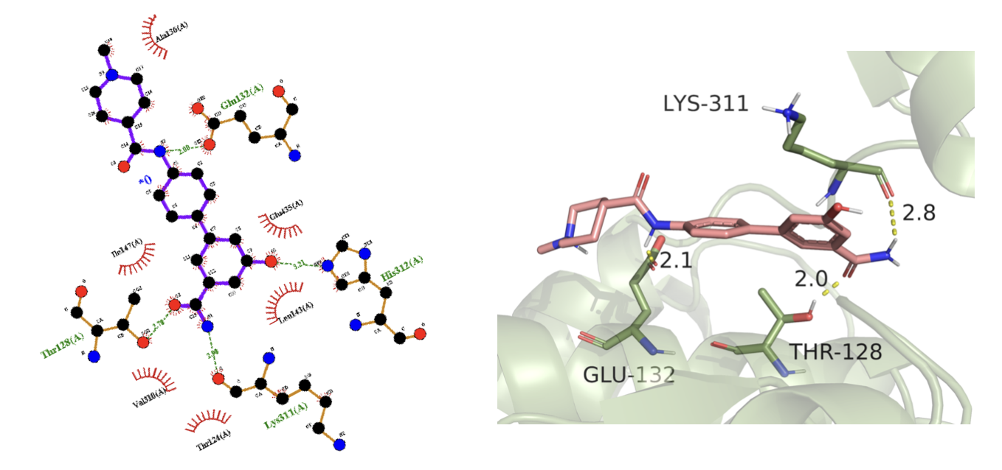

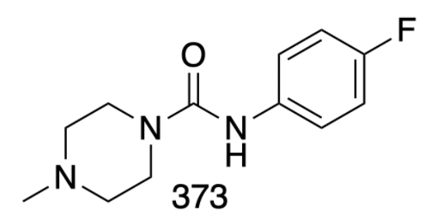


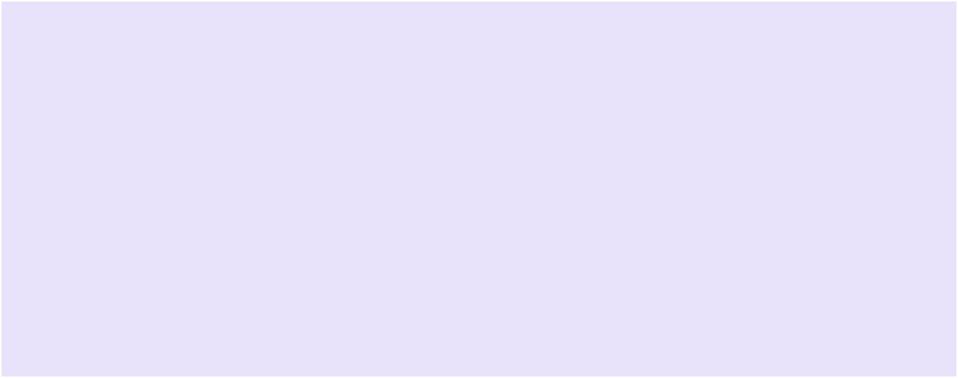


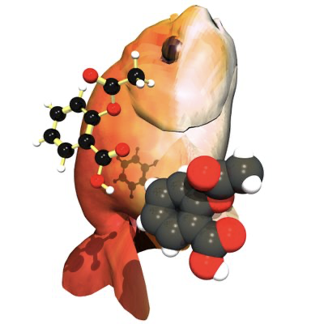
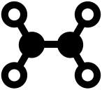
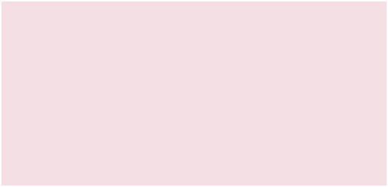



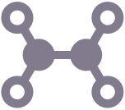




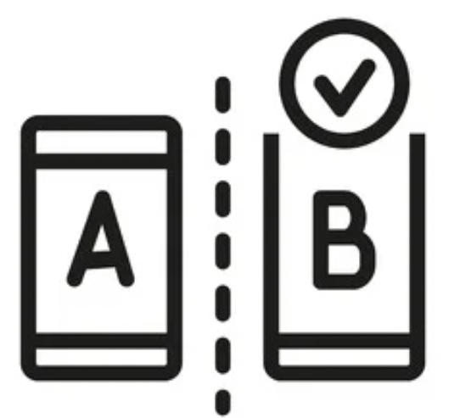
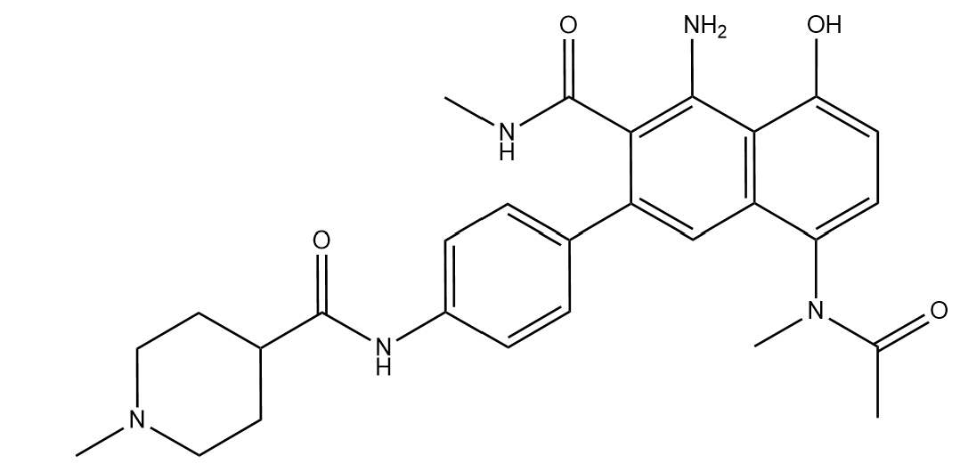


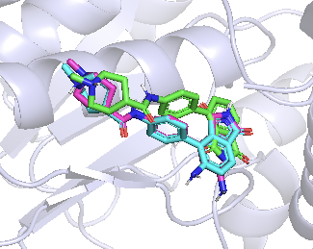

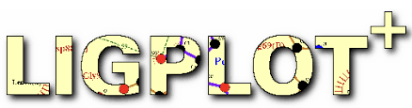

Mur ligases binding site analysis and in silico modulation of the fragments targeting MurD ligase allosteric binding site
Professor Matthew Todd
Zige Bu
UCL SCHOOL OF PHARMACY
BRUNSWICK SQUARE
Introduction & Background information
2D Structures of ligands
45 seconds
a person dies from
antibiotic-resistant [1]
700,000
death annual
worldwide [2]
10 million
estimated death
by 2050 [2]
$100 trillion
loss to world GDP
by 2060 [1]
Serious outcomes caused by antimicrobial resistance bring demands for new research data and novel effective medicine urgently.
MurC/D/E/F ligases are promising targets due to its necessity for the
bacterial cell integrity and similarity in structure and functions. [3]
Results and Discussion
Binding energy: -7.1 KJ/mol ~ -7.3 KJ/mol
Interactions (H bond) with:
Glu132(A) Thr128(A) Lys311(A) His312(A)
18
- High alignment
- ATP-dependent reaction
- Multiple targets inhibition
- Large ATP concentration
(compete with drug)
- Must be selective
Binding energy: -6.7 KJ/mol ~ -7.1 KJ/mol
Interactions (H bond) with:
Glu132(A) Thr128(A) His312(A)
ATP binding site
19
- More crystal structure
- Substrate derivatives
- Well established
binding pocket
- Poor cell penetrance
- Conformation change
- Many competitive
substrates / cofactors
Binding energy: -6.9 KJ/mol ~ -7.3 KJ/mol
Interactions (H bond) with:
Glu132(A) Gly148(A) Lys311(A) His312(A)
Substrate binding site
20
Aims for the project
Binding energy: -7.2 KJ/mol ~ -7.4 KJ/mol
Interactions (H bond) with:
Glu132(A) Thr128(A) Lys311(A) His312(A)
Improve the potency of fragment 373, targeting novel allosteric binding site, by in silico modulation [4]
21
Binding energy
Complexity of the
synthesis process
Conclusions
Binding affinity
Binding interactions
Molecule weight/size
Compound18,19,20,21 has the best performance.
Because they have the features including:
Lower binding energy
Binding poses resemble to the original fragment
More strong interactions with surrounding residues
Materials and Methods
Prepare
compounds
structures
ChemDraw [5] Open Babel [6]
Geometries optimization / Energy minimization
Hydrogenation / Protonation
Future works
Database Autodock MGTool [7]
Target: MurD 3LK7 / Remove H2O molecules
Add missing H atoms / Repair missing bonds
Modification of the part where the ligand is exposed to solvent
Synthesis of the suggested compound, test it against MurD
Prepare target
protein structure
Compound0 Original fragment 373
Determine antibacterial activity: IC50 value, RA,
dose response curve
Analyze the data
Further fragment linking
Develop lead compound
Set control
experiment
Molecular docking
Autodock Vina [7]
Input ligand and enzyme / Set Gird Box
Run the Autodock vina configuration programme
Acknowledgement
I‘d like to express my deepest thanks to all the contributor in OSA team, especially Professor Matthew Todd; Professor Chris Dowson; Miss Kato Leonard; Mr Yuhang Wang; and Miss Becca Steventon.
I’m extremely grateful to my parents and friends for mental support.
Results analysis
and screening
PyMol [8] Ligplot Plus [9]
3D / 2D observation / Calculate RMSD value
Observe ligand-residue interactions
Reference List: [1] 2022. [online] Available at: <https://amr.biomerieux.com/> [Accessed 5 January 2022]. [2] de Kraker, M., Stewardson, A. and Harbarth, S., 2022. Will 10 Million People Die a Year due to Antimicrobial Resistance by 2050?. [3] Kouidmi, I., Levesque, R. and Paradis-Bleau, C., 2014. The biology of Mur ligases as an antibacterial target. Molecular Microbiology, 94(2), pp.242-253. [4] GitHub. 2022. MurD Round 1 · opensourceantibiotics/murligase Wiki. [online] Available at: <https://github.com/opensourceantibiotics/murligase/wiki/MurD-Round-1> [Accessed 20 January 2022]. [5] Cen.acs.org. 2022. [online] Available at: <https://cen.acs.org/articles/92/i33/Reflections-ChemDraw.html> [Accessed 20 January 2022]. [6] O'Boyle, N., Banck, M., James, C., Morley, C., Vandermeersch, T. and Hutchison, G., 2011. Open Babel: An open chemical toolbox. Journal of Cheminformatics, 3(1). [7] Trott, O. and Olson, A., 2009. AutoDock Vina: Improving the speed and accuracy of docking with a new scoring function, efficient optimization, and multithreading. Journal of Computational Chemistry, p.NA-NA. [8] The PyMOL Molecular Graphics System, Version 1.2r3pre, Schrödinger, LLC. [9] LigPlot+: multiple ligand-protein interaction diagrams for drug discovery. Laskowski, Roman A., and Mark B. Swindells. 2011: 2778-2786.

